Slide 1

One component for view in them all

Slide 2



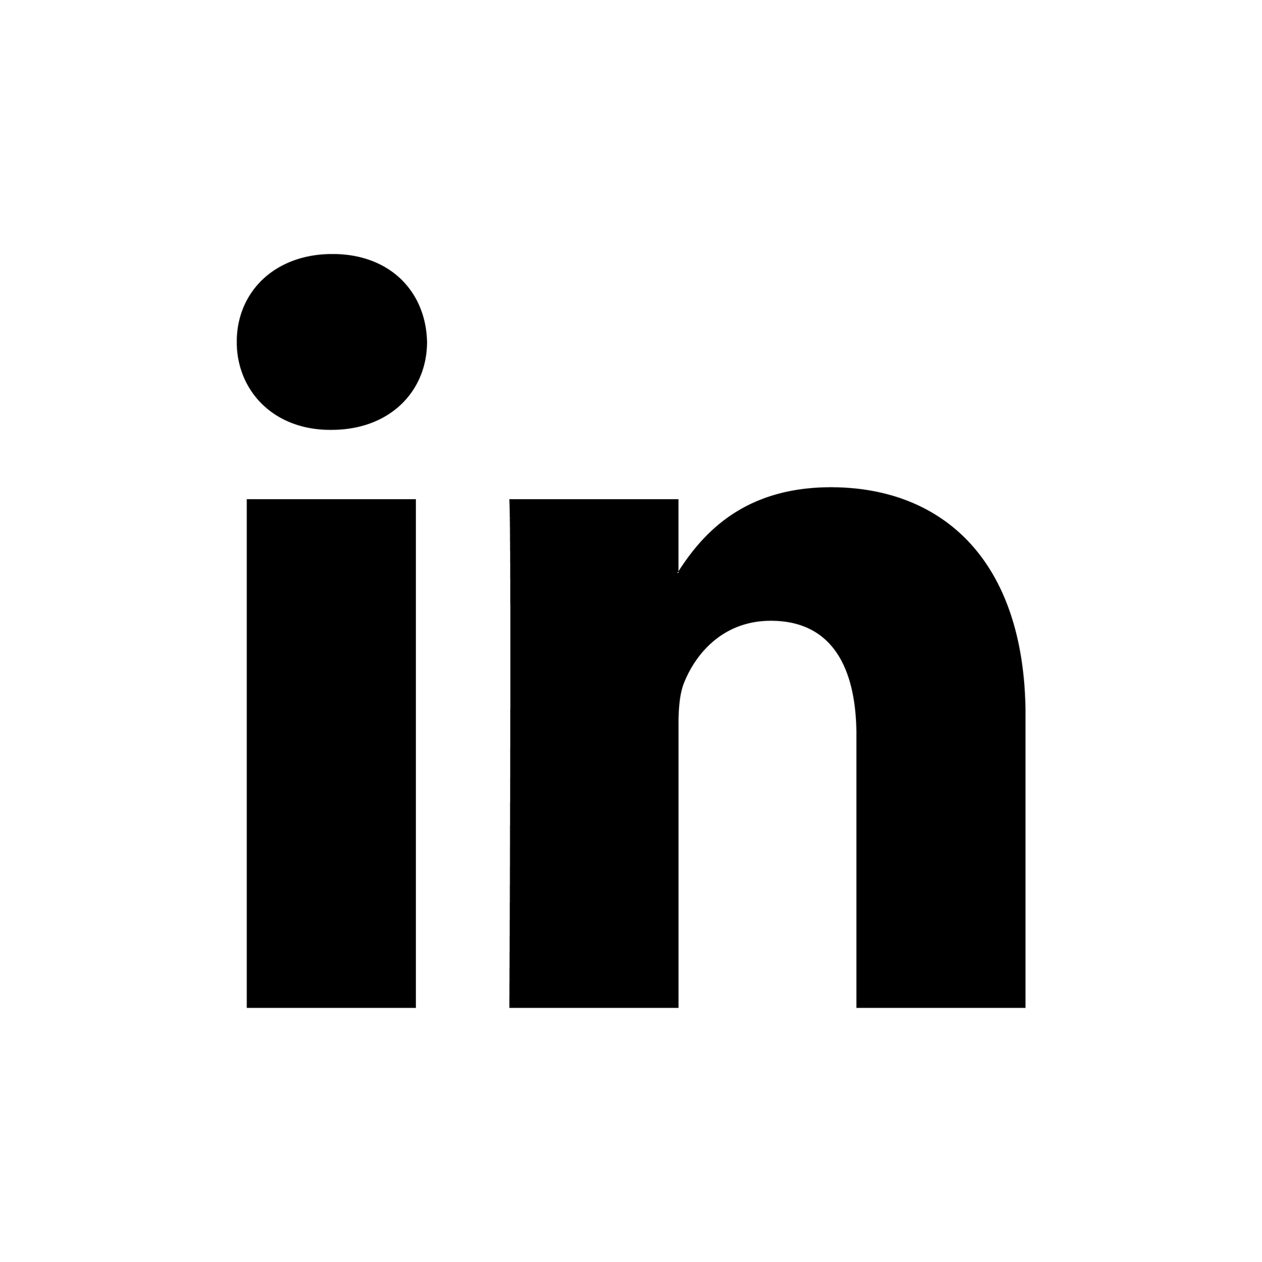
ABOUT ME
I really like my work, software engineering never makes me bored, always keeps in learning and improving mood.
dmytro.zharkov@gmail.com
http://bit.ly/2FAm3Lr
http://bit.ly/2FAm3Lr
Notes:
PLATFORM STRATEGY - Connecting People and Fashion
Our aim is to connect people and fashion
We are building the technological infrastructure for online and mobile fashion commerce that enables all participants to create value through our platform
In everything we do, we serve our customers, brands and partners
Investing in tech is one of the key drivers for connecting people and fashion
Development towards a platform
Zalando is building its own infrastructure
Examples:
- Zalando Lounge: a shopping club for price-conscious customers
- Zalon by Zalando: no shop necessary – stylists put together individual outfits, while Zalando enables the contact between customer and stylist and the stylist is choosing from the wide range of the Zalando shop
- Zalando Media Solutions: connecting brands to consumers
To sum up: Zalando Shop is our key business, but there are many more roles that we can play in our customers lives life in order to satisfy their needs regarding fashion

Slide 3
THE CHALLENGES
Big organizations or companies - large number of teams.
Bounding to one technology (framework or library).
Keeping same “Look and feel” across all of them.
Extra resources to build same UI in different technologies.
Notes:
ADVANTAGE FOR OUR CUSTOMERS
As we think beyond wholesale and work closely with our brands, we are able to provide a wider and deeper assortment as well as a greater brand variety to our customers
PARTNER PROGRAM
Partner program offers our customers a wider assortment and better availability of products
Connecting brands‘ stock of inventory is part of our platform strategy
Win-win:
Use growth opportunities
Enhance the availability of products - cover size outages
Connect brands to customers
Quality and service standards remain the same
More than 170 partners, biggest partners adidas, Mango, Bestseller Group (e.g. Vero Moda, Only) or Superdry
Currently operating in 11 of the 15 Zalando countries (DE, AT, CH, FR, IT, BE, NL, DK, UK, ES, SE)
BRAND SOLUTIONS
… offers many advantages for our brands; no matter if wholesale or partner program
Through brand solutions, brands can create their own shop within the Zalando shop, similar to a flagship store
We put our brands in the director‘s seat
Who knows better about the latest campaign, product etc.
Brands have great products, great content, great stories. So why not connect them directly to customers? Customers would be able to follow brands they like, live in that brand universe, always get the latest news.
Easy purchase transaction, data analysis, insights into customers’ behaviors
But Brand Solutions are not only Brand Shops, also Content Management System, Analytics and other tools

Slide 4
THE PROPOSAL
NATIVE WEB COMPONENTS TO CREATE FRAMEWORK AGNOSTIC REUSABLE UI LIBRARIES.
Notes:
ADVANTAGE FOR OUR CUSTOMERS
As we think beyond wholesale and work closely with our brands, we are able to provide a wider and deeper assortment as well as a greater brand variety to our customers
PARTNER PROGRAM
Partner program offers our customers a wider assortment and better availability of products
Connecting brands‘ stock of inventory is part of our platform strategy
Win-win:
Use growth opportunities
Enhance the availability of products - cover size outages
Connect brands to customers
Quality and service standards remain the same
More than 170 partners, biggest partners adidas, Mango, Bestseller Group (e.g. Vero Moda, Only) or Superdry
Currently operating in 11 of the 15 Zalando countries (DE, AT, CH, FR, IT, BE, NL, DK, UK, ES, SE)
BRAND SOLUTIONS
… offers many advantages for our brands; no matter if wholesale or partner program
Through brand solutions, brands can create their own shop within the Zalando shop, similar to a flagship store
We put our brands in the director‘s seat
Who knows better about the latest campaign, product etc.
Brands have great products, great content, great stories. So why not connect them directly to customers? Customers would be able to follow brands they like, live in that brand universe, always get the latest news.
Easy purchase transaction, data analysis, insights into customers’ behaviors
But Brand Solutions are not only Brand Shops, also Content Management System, Analytics and other tools

Slide 5
COMPONENT BASED JS FRAMEWORKS
ANGULAR
REACT
VUE
EMBER
ANGULAR JS
AURELIA
Notes:
ADVANTAGE FOR OUR CUSTOMERS
As we think beyond wholesale and work closely with our brands, we are able to provide a wider and deeper assortment as well as a greater brand variety to our customers
PARTNER PROGRAM
Partner program offers our customers a wider assortment and better availability of products
Connecting brands‘ stock of inventory is part of our platform strategy
Win-win:
Use growth opportunities
Enhance the availability of products - cover size outages
Connect brands to customers
Quality and service standards remain the same
More than 170 partners, biggest partners adidas, Mango, Bestseller Group (e.g. Vero Moda, Only) or Superdry
Currently operating in 11 of the 15 Zalando countries (DE, AT, CH, FR, IT, BE, NL, DK, UK, ES, SE)
BRAND SOLUTIONS
… offers many advantages for our brands; no matter if wholesale or partner program
Through brand solutions, brands can create their own shop within the Zalando shop, similar to a flagship store
We put our brands in the director‘s seat
Who knows better about the latest campaign, product etc.
Brands have great products, great content, great stories. So why not connect them directly to customers? Customers would be able to follow brands they like, live in that brand universe, always get the latest news.
Easy purchase transaction, data analysis, insights into customers’ behaviors
But Brand Solutions are not only Brand Shops, also Content Management System, Analytics and other tools

Slide 6
WEB COMPONENT WORLD
Native web components api
Bosonic is a collection of components designed to meet the everyday needs of web developers.
Polymer provides a set of features for creating custom elements.
SkateJS is a JavaScript library for writing web components with a small footprint.
Slim.js is an open source lightweight web component library.
Stencil is an open source compiler that generates standards-compliant web components.
Notes:
ADVANTAGE FOR OUR CUSTOMERS
As we think beyond wholesale and work closely with our brands, we are able to provide a wider and deeper assortment as well as a greater brand variety to our customers
PARTNER PROGRAM
Partner program offers our customers a wider assortment and better availability of products
Connecting brands‘ stock of inventory is part of our platform strategy
Win-win:
Use growth opportunities
Enhance the availability of products - cover size outages
Connect brands to customers
Quality and service standards remain the same
More than 170 partners, biggest partners adidas, Mango, Bestseller Group (e.g. Vero Moda, Only) or Superdry
Currently operating in 11 of the 15 Zalando countries (DE, AT, CH, FR, IT, BE, NL, DK, UK, ES, SE)
BRAND SOLUTIONS
… offers many advantages for our brands; no matter if wholesale or partner program
Through brand solutions, brands can create their own shop within the Zalando shop, similar to a flagship store
We put our brands in the director‘s seat
Who knows better about the latest campaign, product etc.
Brands have great products, great content, great stories. So why not connect them directly to customers? Customers would be able to follow brands they like, live in that brand universe, always get the latest news.
Easy purchase transaction, data analysis, insights into customers’ behaviors
But Brand Solutions are not only Brand Shops, also Content Management System, Analytics and other tools

Slide 7
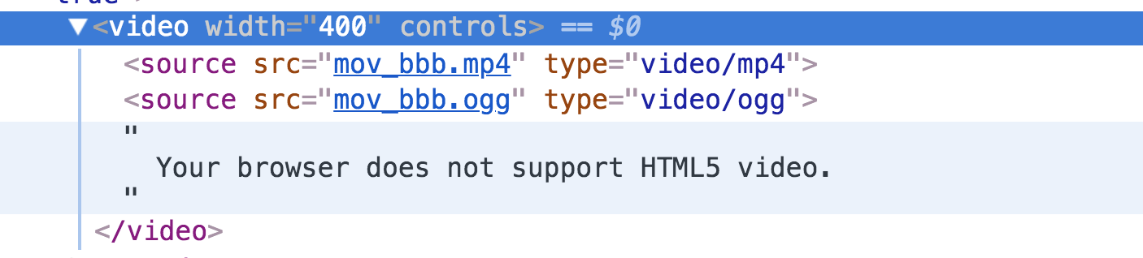
It’s there for quite a time
Notes:
ADVANTAGE FOR OUR CUSTOMERS
As we think beyond wholesale and work closely with our brands, we are able to provide a wider and deeper assortment as well as a greater brand variety to our customers
PARTNER PROGRAM
Partner program offers our customers a wider assortment and better availability of products
Connecting brands‘ stock of inventory is part of our platform strategy
Win-win:
Use growth opportunities
Enhance the availability of products - cover size outages
Connect brands to customers
Quality and service standards remain the same
More than 170 partners, biggest partners adidas, Mango, Bestseller Group (e.g. Vero Moda, Only) or Superdry
Currently operating in 11 of the 15 Zalando countries (DE, AT, CH, FR, IT, BE, NL, DK, UK, ES, SE)
BRAND SOLUTIONS
… offers many advantages for our brands; no matter if wholesale or partner program
Through brand solutions, brands can create their own shop within the Zalando shop, similar to a flagship store
We put our brands in the director‘s seat
Who knows better about the latest campaign, product etc.
Brands have great products, great content, great stories. So why not connect them directly to customers? Customers would be able to follow brands they like, live in that brand universe, always get the latest news.
Easy purchase transaction, data analysis, insights into customers’ behaviors
But Brand Solutions are not only Brand Shops, also Content Management System, Analytics and other tools

Slide 8
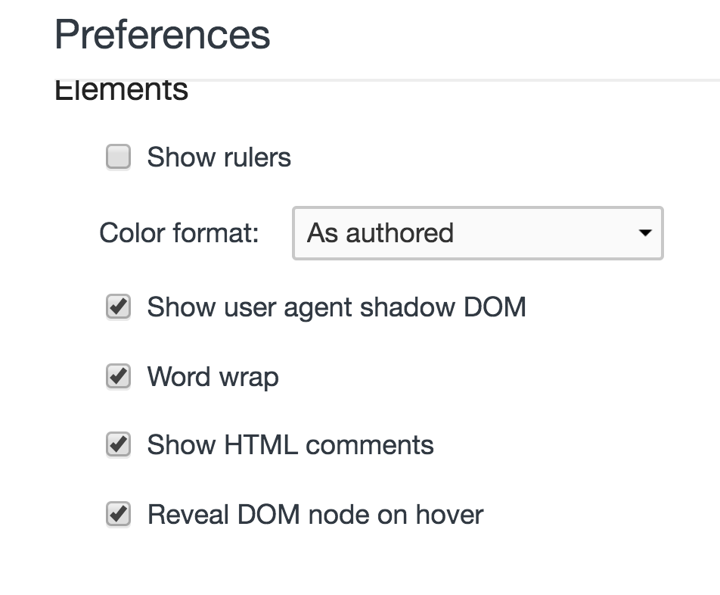
Notes:
ADVANTAGE FOR OUR CUSTOMERS
As we think beyond wholesale and work closely with our brands, we are able to provide a wider and deeper assortment as well as a greater brand variety to our customers
PARTNER PROGRAM
Partner program offers our customers a wider assortment and better availability of products
Connecting brands‘ stock of inventory is part of our platform strategy
Win-win:
Use growth opportunities
Enhance the availability of products - cover size outages
Connect brands to customers
Quality and service standards remain the same
More than 170 partners, biggest partners adidas, Mango, Bestseller Group (e.g. Vero Moda, Only) or Superdry
Currently operating in 11 of the 15 Zalando countries (DE, AT, CH, FR, IT, BE, NL, DK, UK, ES, SE)
BRAND SOLUTIONS
… offers many advantages for our brands; no matter if wholesale or partner program
Through brand solutions, brands can create their own shop within the Zalando shop, similar to a flagship store
We put our brands in the director‘s seat
Who knows better about the latest campaign, product etc.
Brands have great products, great content, great stories. So why not connect them directly to customers? Customers would be able to follow brands they like, live in that brand universe, always get the latest news.
Easy purchase transaction, data analysis, insights into customers’ behaviors
But Brand Solutions are not only Brand Shops, also Content Management System, Analytics and other tools

Slide 9
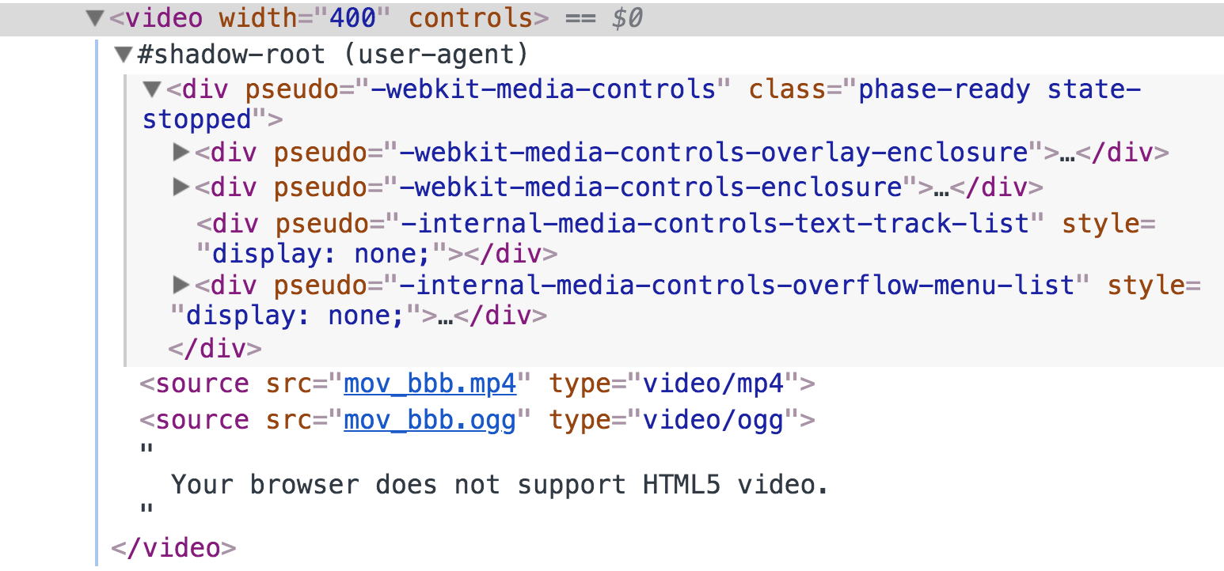
Notes:
ADVANTAGE FOR OUR CUSTOMERS
As we think beyond wholesale and work closely with our brands, we are able to provide a wider and deeper assortment as well as a greater brand variety to our customers
PARTNER PROGRAM
Partner program offers our customers a wider assortment and better availability of products
Connecting brands‘ stock of inventory is part of our platform strategy
Win-win:
Use growth opportunities
Enhance the availability of products - cover size outages
Connect brands to customers
Quality and service standards remain the same
More than 170 partners, biggest partners adidas, Mango, Bestseller Group (e.g. Vero Moda, Only) or Superdry
Currently operating in 11 of the 15 Zalando countries (DE, AT, CH, FR, IT, BE, NL, DK, UK, ES, SE)
BRAND SOLUTIONS
… offers many advantages for our brands; no matter if wholesale or partner program
Through brand solutions, brands can create their own shop within the Zalando shop, similar to a flagship store
We put our brands in the director‘s seat
Who knows better about the latest campaign, product etc.
Brands have great products, great content, great stories. So why not connect them directly to customers? Customers would be able to follow brands they like, live in that brand universe, always get the latest news.
Easy purchase transaction, data analysis, insights into customers’ behaviors
But Brand Solutions are not only Brand Shops, also Content Management System, Analytics and other tools

Slide 10
Web component recipe
1. Set a custom element (tag):
customElements.define("z-product-card", elementClassDefinition);
2. Define component class extending from HTMLElement:
customElements.define("z-product-card",
class ZProductCard extends HTMLElement {
});
3. Add your component’s markup with template tag or set it manually.
4. Attach a shadow DOM and append your template to it:
let shadowRoot = this.attachShadow({mode: 'open'});
shadowRoot.appendChild(templateContent.cloneNode(true));
5. Depending on requirements add a polyfills:
npm install @webcomponents/webcomponentsjs -S
Notes:
ADVANTAGE FOR OUR CUSTOMERS
As we think beyond wholesale and work closely with our brands, we are able to provide a wider and deeper assortment as well as a greater brand variety to our customers
PARTNER PROGRAM
Partner program offers our customers a wider assortment and better availability of products
Connecting brands‘ stock of inventory is part of our platform strategy
Win-win:
Use growth opportunities
Enhance the availability of products - cover size outages
Connect brands to customers
Quality and service standards remain the same
More than 170 partners, biggest partners adidas, Mango, Bestseller Group (e.g. Vero Moda, Only) or Superdry
Currently operating in 11 of the 15 Zalando countries (DE, AT, CH, FR, IT, BE, NL, DK, UK, ES, SE)
BRAND SOLUTIONS
… offers many advantages for our brands; no matter if wholesale or partner program
Through brand solutions, brands can create their own shop within the Zalando shop, similar to a flagship store
We put our brands in the director‘s seat
Who knows better about the latest campaign, product etc.
Brands have great products, great content, great stories. So why not connect them directly to customers? Customers would be able to follow brands they like, live in that brand universe, always get the latest news.
Easy purchase transaction, data analysis, insights into customers’ behaviors
But Brand Solutions are not only Brand Shops, also Content Management System, Analytics and other tools

Slide 11
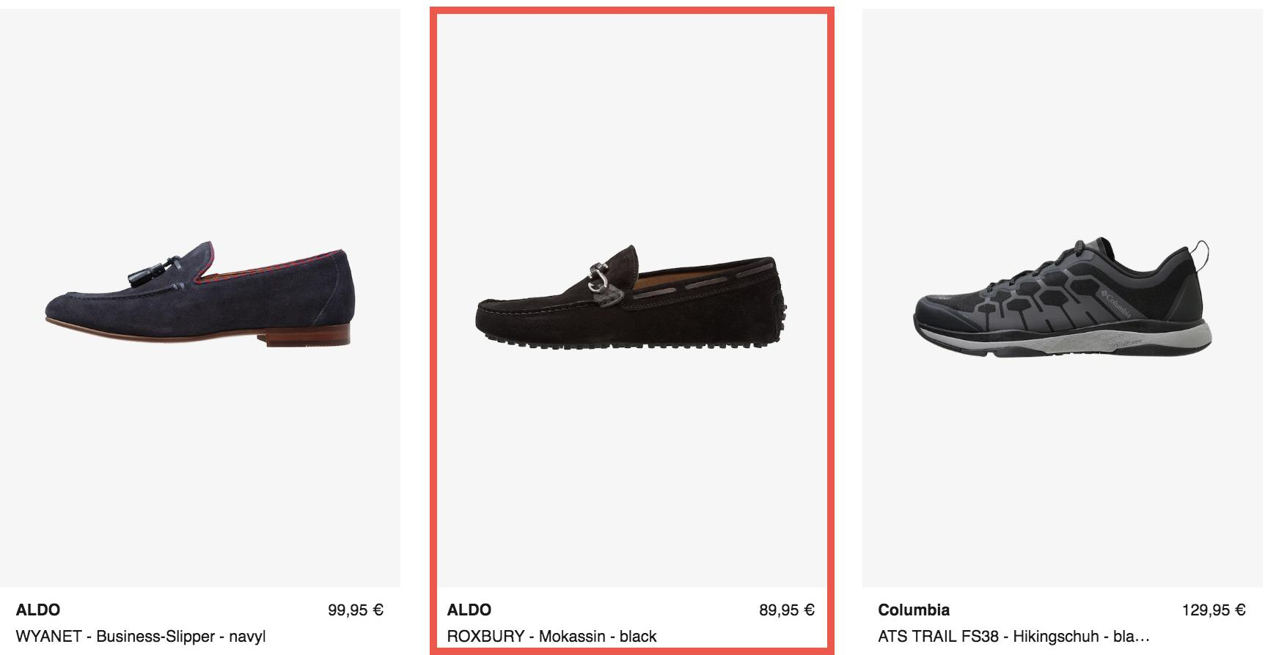
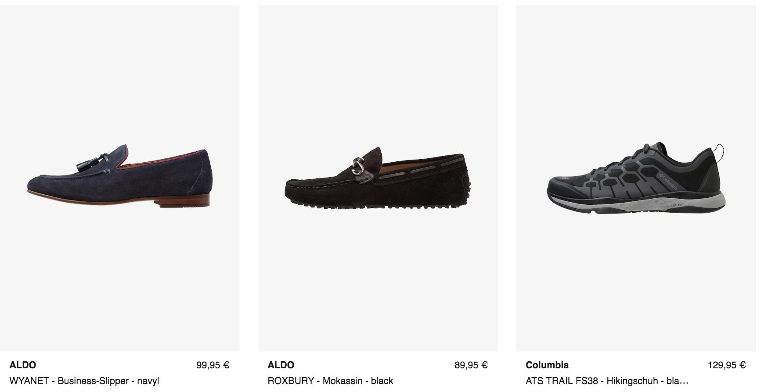
EXAMPLE: A PRODUCT CARD COMPONENT
Notes:
ADVANTAGE FOR OUR CUSTOMERS
As we think beyond wholesale and work closely with our brands, we are able to provide a wider and deeper assortment as well as a greater brand variety to our customers
PARTNER PROGRAM
Partner program offers our customers a wider assortment and better availability of products
Connecting brands‘ stock of inventory is part of our platform strategy
Win-win:
Use growth opportunities
Enhance the availability of products - cover size outages
Connect brands to customers
Quality and service standards remain the same
More than 170 partners, biggest partners adidas, Mango, Bestseller Group (e.g. Vero Moda, Only) or Superdry
Currently operating in 11 of the 15 Zalando countries (DE, AT, CH, FR, IT, BE, NL, DK, UK, ES, SE)
BRAND SOLUTIONS
… offers many advantages for our brands; no matter if wholesale or partner program
Through brand solutions, brands can create their own shop within the Zalando shop, similar to a flagship store
We put our brands in the director‘s seat
Who knows better about the latest campaign, product etc.
Brands have great products, great content, great stories. So why not connect them directly to customers? Customers would be able to follow brands they like, live in that brand universe, always get the latest news.
Easy purchase transaction, data analysis, insights into customers’ behaviors
But Brand Solutions are not only Brand Shops, also Content Management System, Analytics and other tools

Slide 12
Web component recipe
DEMO
Notes:
ADVANTAGE FOR OUR CUSTOMERS
As we think beyond wholesale and work closely with our brands, we are able to provide a wider and deeper assortment as well as a greater brand variety to our customers
PARTNER PROGRAM
Partner program offers our customers a wider assortment and better availability of products
Connecting brands‘ stock of inventory is part of our platform strategy
Win-win:
Use growth opportunities
Enhance the availability of products - cover size outages
Connect brands to customers
Quality and service standards remain the same
More than 170 partners, biggest partners adidas, Mango, Bestseller Group (e.g. Vero Moda, Only) or Superdry
Currently operating in 11 of the 15 Zalando countries (DE, AT, CH, FR, IT, BE, NL, DK, UK, ES, SE)
BRAND SOLUTIONS
… offers many advantages for our brands; no matter if wholesale or partner program
Through brand solutions, brands can create their own shop within the Zalando shop, similar to a flagship store
We put our brands in the director‘s seat
Who knows better about the latest campaign, product etc.
Brands have great products, great content, great stories. So why not connect them directly to customers? Customers would be able to follow brands they like, live in that brand universe, always get the latest news.
Easy purchase transaction, data analysis, insights into customers’ behaviors
But Brand Solutions are not only Brand Shops, also Content Management System, Analytics and other tools

Slide 13
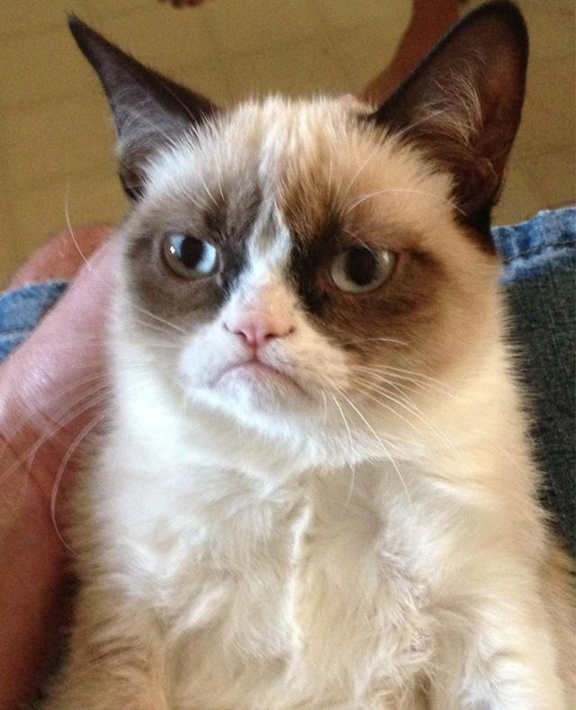
The drawbacks :(
Lots of boilerplate code to setup over and over.
Browser support. Need to include various polyfills yourself.
Adapt your code to use those polyfills.
You have to setup bundling, building etc.
Notes:
ADVANTAGE FOR OUR CUSTOMERS
As we think beyond wholesale and work closely with our brands, we are able to provide a wider and deeper assortment as well as a greater brand variety to our customers
PARTNER PROGRAM
Partner program offers our customers a wider assortment and better availability of products
Connecting brands‘ stock of inventory is part of our platform strategy
Win-win:
Use growth opportunities
Enhance the availability of products - cover size outages
Connect brands to customers
Quality and service standards remain the same
More than 170 partners, biggest partners adidas, Mango, Bestseller Group (e.g. Vero Moda, Only) or Superdry
Currently operating in 11 of the 15 Zalando countries (DE, AT, CH, FR, IT, BE, NL, DK, UK, ES, SE)
BRAND SOLUTIONS
… offers many advantages for our brands; no matter if wholesale or partner program
Through brand solutions, brands can create their own shop within the Zalando shop, similar to a flagship store
We put our brands in the director‘s seat
Who knows better about the latest campaign, product etc.
Brands have great products, great content, great stories. So why not connect them directly to customers? Customers would be able to follow brands they like, live in that brand universe, always get the latest news.
Easy purchase transaction, data analysis, insights into customers’ behaviors
But Brand Solutions are not only Brand Shops, also Content Management System, Analytics and other tools

Slide 14
STENCIL: REUSABLE WEB COMPONENT COMPILER
Developed by Ionic team.
Not a library, just a compiler.
Virtual DOM
Async rendering (inspired by React Fiber)
Reactive data-binding
TypeScript
Lazy loading. Polyfills are loaded only when needed.
JSX
Notes:
ADVANTAGE FOR OUR CUSTOMERS
As we think beyond wholesale and work closely with our brands, we are able to provide a wider and deeper assortment as well as a greater brand variety to our customers
PARTNER PROGRAM
Partner program offers our customers a wider assortment and better availability of products
Connecting brands‘ stock of inventory is part of our platform strategy
Win-win:
Use growth opportunities
Enhance the availability of products - cover size outages
Connect brands to customers
Quality and service standards remain the same
More than 170 partners, biggest partners adidas, Mango, Bestseller Group (e.g. Vero Moda, Only) or Superdry
Currently operating in 11 of the 15 Zalando countries (DE, AT, CH, FR, IT, BE, NL, DK, UK, ES, SE)
BRAND SOLUTIONS
… offers many advantages for our brands; no matter if wholesale or partner program
Through brand solutions, brands can create their own shop within the Zalando shop, similar to a flagship store
We put our brands in the director‘s seat
Who knows better about the latest campaign, product etc.
Brands have great products, great content, great stories. So why not connect them directly to customers? Customers would be able to follow brands they like, live in that brand universe, always get the latest news.
Easy purchase transaction, data analysis, insights into customers’ behaviors
But Brand Solutions are not only Brand Shops, also Content Management System, Analytics and other tools

Slide 15
STENCIL COMPONENT EXAMPLE
1. Define component classwith @Component decorator
@Component({
tag: 'z-product-card',
styleUrl: 'z-product-card.css',
shadow: true
})
export class ZProductCard {
}
@Component({
Notes:
ADVANTAGE FOR OUR CUSTOMERS
As we think beyond wholesale and work closely with our brands, we are able to provide a wider and deeper assortment as well as a greater brand variety to our customers
PARTNER PROGRAM
Partner program offers our customers a wider assortment and better availability of products
Connecting brands‘ stock of inventory is part of our platform strategy
Win-win:
Use growth opportunities
Enhance the availability of products - cover size outages
Connect brands to customers
Quality and service standards remain the same
More than 170 partners, biggest partners adidas, Mango, Bestseller Group (e.g. Vero Moda, Only) or Superdry
Currently operating in 11 of the 15 Zalando countries (DE, AT, CH, FR, IT, BE, NL, DK, UK, ES, SE)
BRAND SOLUTIONS
… offers many advantages for our brands; no matter if wholesale or partner program
Through brand solutions, brands can create their own shop within the Zalando shop, similar to a flagship store
We put our brands in the director‘s seat
Who knows better about the latest campaign, product etc.
Brands have great products, great content, great stories. So why not connect them directly to customers? Customers would be able to follow brands they like, live in that brand universe, always get the latest news.
Easy purchase transaction, data analysis, insights into customers’ behaviors
But Brand Solutions are not only Brand Shops, also Content Management System, Analytics and other tools

Slide 16
STENCIL COMPONENT EXAMPLE
2. Add properties and events with decorators
export class ZProductCard {
@Prop() product: any;
@Event() productLiked: EventEmitter;
productLikedHandler() {
this.productLiked.emit(this.product);
}
render() {
return <div>Components html here</div>
}
}
@Prop() product: any;
@Event() productLiked: EventEmitter;
Notes:
ADVANTAGE FOR OUR CUSTOMERS
As we think beyond wholesale and work closely with our brands, we are able to provide a wider and deeper assortment as well as a greater brand variety to our customers
PARTNER PROGRAM
Partner program offers our customers a wider assortment and better availability of products
Connecting brands‘ stock of inventory is part of our platform strategy
Win-win:
Use growth opportunities
Enhance the availability of products - cover size outages
Connect brands to customers
Quality and service standards remain the same
More than 170 partners, biggest partners adidas, Mango, Bestseller Group (e.g. Vero Moda, Only) or Superdry
Currently operating in 11 of the 15 Zalando countries (DE, AT, CH, FR, IT, BE, NL, DK, UK, ES, SE)
BRAND SOLUTIONS
… offers many advantages for our brands; no matter if wholesale or partner program
Through brand solutions, brands can create their own shop within the Zalando shop, similar to a flagship store
We put our brands in the director‘s seat
Who knows better about the latest campaign, product etc.
Brands have great products, great content, great stories. So why not connect them directly to customers? Customers would be able to follow brands they like, live in that brand universe, always get the latest news.
Easy purchase transaction, data analysis, insights into customers’ behaviors
But Brand Solutions are not only Brand Shops, also Content Management System, Analytics and other tools

Slide 17
STENCIL COMPONENT EXAMPLE
DEMO
Notes:
ADVANTAGE FOR OUR CUSTOMERS
As we think beyond wholesale and work closely with our brands, we are able to provide a wider and deeper assortment as well as a greater brand variety to our customers
PARTNER PROGRAM
Partner program offers our customers a wider assortment and better availability of products
Connecting brands‘ stock of inventory is part of our platform strategy
Win-win:
Use growth opportunities
Enhance the availability of products - cover size outages
Connect brands to customers
Quality and service standards remain the same
More than 170 partners, biggest partners adidas, Mango, Bestseller Group (e.g. Vero Moda, Only) or Superdry
Currently operating in 11 of the 15 Zalando countries (DE, AT, CH, FR, IT, BE, NL, DK, UK, ES, SE)
BRAND SOLUTIONS
… offers many advantages for our brands; no matter if wholesale or partner program
Through brand solutions, brands can create their own shop within the Zalando shop, similar to a flagship store
We put our brands in the director‘s seat
Who knows better about the latest campaign, product etc.
Brands have great products, great content, great stories. So why not connect them directly to customers? Customers would be able to follow brands they like, live in that brand universe, always get the latest news.
Easy purchase transaction, data analysis, insights into customers’ behaviors
But Brand Solutions are not only Brand Shops, also Content Management System, Analytics and other tools

Slide 18
Stencil & Angular CLI
1. Add assets and scripts to cli configuration file: angular.json
"assets": [
{ "glob": "**/*", "input": "./node_modules/z-product-card/dist/zlib", "output": "./zlib" },
{ "glob": "**/*", "input": "./node_modules/z-product-card/dist/collection/assets", "output": "./assets" }
],
"scripts": [
"./node_modules/z-product-card/dist/zlib.js"
]
Notes:
ADVANTAGE FOR OUR CUSTOMERS
As we think beyond wholesale and work closely with our brands, we are able to provide a wider and deeper assortment as well as a greater brand variety to our customers
PARTNER PROGRAM
Partner program offers our customers a wider assortment and better availability of products
Connecting brands‘ stock of inventory is part of our platform strategy
Win-win:
Use growth opportunities
Enhance the availability of products - cover size outages
Connect brands to customers
Quality and service standards remain the same
More than 170 partners, biggest partners adidas, Mango, Bestseller Group (e.g. Vero Moda, Only) or Superdry
Currently operating in 11 of the 15 Zalando countries (DE, AT, CH, FR, IT, BE, NL, DK, UK, ES, SE)
BRAND SOLUTIONS
… offers many advantages for our brands; no matter if wholesale or partner program
Through brand solutions, brands can create their own shop within the Zalando shop, similar to a flagship store
We put our brands in the director‘s seat
Who knows better about the latest campaign, product etc.
Brands have great products, great content, great stories. So why not connect them directly to customers? Customers would be able to follow brands they like, live in that brand universe, always get the latest news.
Easy purchase transaction, data analysis, insights into customers’ behaviors
But Brand Solutions are not only Brand Shops, also Content Management System, Analytics and other tools

Slide 19
Stencil & Angular CLI
2. Add CUSTOM_ELEMENTS_SCHEMA to let angular ignore unknown elements
@NgModule({
declarations: [
AppComponent
],
imports: [
BrowserModule
],
bootstrap: [AppComponent],
schemas: [
]
})
CUSTOM_ELEMENTS_SCHEMA
Notes:
ADVANTAGE FOR OUR CUSTOMERS
As we think beyond wholesale and work closely with our brands, we are able to provide a wider and deeper assortment as well as a greater brand variety to our customers
PARTNER PROGRAM
Partner program offers our customers a wider assortment and better availability of products
Connecting brands‘ stock of inventory is part of our platform strategy
Win-win:
Use growth opportunities
Enhance the availability of products - cover size outages
Connect brands to customers
Quality and service standards remain the same
More than 170 partners, biggest partners adidas, Mango, Bestseller Group (e.g. Vero Moda, Only) or Superdry
Currently operating in 11 of the 15 Zalando countries (DE, AT, CH, FR, IT, BE, NL, DK, UK, ES, SE)
BRAND SOLUTIONS
… offers many advantages for our brands; no matter if wholesale or partner program
Through brand solutions, brands can create their own shop within the Zalando shop, similar to a flagship store
We put our brands in the director‘s seat
Who knows better about the latest campaign, product etc.
Brands have great products, great content, great stories. So why not connect them directly to customers? Customers would be able to follow brands they like, live in that brand universe, always get the latest news.
Easy purchase transaction, data analysis, insights into customers’ behaviors
But Brand Solutions are not only Brand Shops, also Content Management System, Analytics and other tools

Slide 20
Stencil & Angular CLI
<z-product-card *ngFor="let product of products"
[product]="product"
(productLiked)="onProductLiked($event)" class="product-grid-item">
</z-product-card>
export class AppComponent {
public products: any = products;
public likedProducts: any = [];
public onProductLiked(evt: any) {
this.likedProducts.push(evt.detail);
}
}
[product]="product"
(productLiked)="onProductLiked($event)"
Notes:
ADVANTAGE FOR OUR CUSTOMERS
As we think beyond wholesale and work closely with our brands, we are able to provide a wider and deeper assortment as well as a greater brand variety to our customers
PARTNER PROGRAM
Partner program offers our customers a wider assortment and better availability of products
Connecting brands‘ stock of inventory is part of our platform strategy
Win-win:
Use growth opportunities
Enhance the availability of products - cover size outages
Connect brands to customers
Quality and service standards remain the same
More than 170 partners, biggest partners adidas, Mango, Bestseller Group (e.g. Vero Moda, Only) or Superdry
Currently operating in 11 of the 15 Zalando countries (DE, AT, CH, FR, IT, BE, NL, DK, UK, ES, SE)
BRAND SOLUTIONS
… offers many advantages for our brands; no matter if wholesale or partner program
Through brand solutions, brands can create their own shop within the Zalando shop, similar to a flagship store
We put our brands in the director‘s seat
Who knows better about the latest campaign, product etc.
Brands have great products, great content, great stories. So why not connect them directly to customers? Customers would be able to follow brands they like, live in that brand universe, always get the latest news.
Easy purchase transaction, data analysis, insights into customers’ behaviors
But Brand Solutions are not only Brand Shops, also Content Management System, Analytics and other tools

Slide 21
Stencil & React
1. Add the stencil component to your build.
Use copy-webpack-plugin to copy components files to destination folder:
plugins: [
new CopyWebpackPlugin([{ from: './node_modules/z-product-card/dist', to: './z-product-card' }])
]
Add a reference to your index.html file:
<script src="%PUBLIC_URL%/z-product-card/zlib.js"></script>
Notes:
ADVANTAGE FOR OUR CUSTOMERS
As we think beyond wholesale and work closely with our brands, we are able to provide a wider and deeper assortment as well as a greater brand variety to our customers
PARTNER PROGRAM
Partner program offers our customers a wider assortment and better availability of products
Connecting brands‘ stock of inventory is part of our platform strategy
Win-win:
Use growth opportunities
Enhance the availability of products - cover size outages
Connect brands to customers
Quality and service standards remain the same
More than 170 partners, biggest partners adidas, Mango, Bestseller Group (e.g. Vero Moda, Only) or Superdry
Currently operating in 11 of the 15 Zalando countries (DE, AT, CH, FR, IT, BE, NL, DK, UK, ES, SE)
BRAND SOLUTIONS
… offers many advantages for our brands; no matter if wholesale or partner program
Through brand solutions, brands can create their own shop within the Zalando shop, similar to a flagship store
We put our brands in the director‘s seat
Who knows better about the latest campaign, product etc.
Brands have great products, great content, great stories. So why not connect them directly to customers? Customers would be able to follow brands they like, live in that brand universe, always get the latest news.
Easy purchase transaction, data analysis, insights into customers’ behaviors
But Brand Solutions are not only Brand Shops, also Content Management System, Analytics and other tools

Slide 22
Stencil & React
2. Add your component to render function:
render() {
const productsHtml = this.products.map((product, i) => {
return (
<z-product-card product={this.processProductData(product)}></z-product-card>
);
});
return (
<div className="demo-container">
{productsHtml}
</div>
);
}
Notes:
ADVANTAGE FOR OUR CUSTOMERS
As we think beyond wholesale and work closely with our brands, we are able to provide a wider and deeper assortment as well as a greater brand variety to our customers
PARTNER PROGRAM
Partner program offers our customers a wider assortment and better availability of products
Connecting brands‘ stock of inventory is part of our platform strategy
Win-win:
Use growth opportunities
Enhance the availability of products - cover size outages
Connect brands to customers
Quality and service standards remain the same
More than 170 partners, biggest partners adidas, Mango, Bestseller Group (e.g. Vero Moda, Only) or Superdry
Currently operating in 11 of the 15 Zalando countries (DE, AT, CH, FR, IT, BE, NL, DK, UK, ES, SE)
BRAND SOLUTIONS
… offers many advantages for our brands; no matter if wholesale or partner program
Through brand solutions, brands can create their own shop within the Zalando shop, similar to a flagship store
We put our brands in the director‘s seat
Who knows better about the latest campaign, product etc.
Brands have great products, great content, great stories. So why not connect them directly to customers? Customers would be able to follow brands they like, live in that brand universe, always get the latest news.
Easy purchase transaction, data analysis, insights into customers’ behaviors
But Brand Solutions are not only Brand Shops, also Content Management System, Analytics and other tools

Slide 23
Stencil & React
3. React calls toString() method on properties this casses an input to component ti equal "[object Object]".
Add a function to transform data into string to avoid it.
processProductData(data) {
if (data) {
return JSON.stringify(data);
}
}
Notes:
ADVANTAGE FOR OUR CUSTOMERS
As we think beyond wholesale and work closely with our brands, we are able to provide a wider and deeper assortment as well as a greater brand variety to our customers
PARTNER PROGRAM
Partner program offers our customers a wider assortment and better availability of products
Connecting brands‘ stock of inventory is part of our platform strategy
Win-win:
Use growth opportunities
Enhance the availability of products - cover size outages
Connect brands to customers
Quality and service standards remain the same
More than 170 partners, biggest partners adidas, Mango, Bestseller Group (e.g. Vero Moda, Only) or Superdry
Currently operating in 11 of the 15 Zalando countries (DE, AT, CH, FR, IT, BE, NL, DK, UK, ES, SE)
BRAND SOLUTIONS
… offers many advantages for our brands; no matter if wholesale or partner program
Through brand solutions, brands can create their own shop within the Zalando shop, similar to a flagship store
We put our brands in the director‘s seat
Who knows better about the latest campaign, product etc.
Brands have great products, great content, great stories. So why not connect them directly to customers? Customers would be able to follow brands they like, live in that brand universe, always get the latest news.
Easy purchase transaction, data analysis, insights into customers’ behaviors
But Brand Solutions are not only Brand Shops, also Content Management System, Analytics and other tools

Slide 24
Stencil & React
4. Subscribe to custom component events:
componentDidMount() {
ReactDOM.findDOMNode(this).addEventListener("productLiked", (e) => {
liked.push(JSON.parse(e.detail));
this.setState({
likedProducts: this.state.likedProducts
});
});
}
ReactDOM.findDOMNode(this).addEventListener("productLiked
Notes:
ADVANTAGE FOR OUR CUSTOMERS
As we think beyond wholesale and work closely with our brands, we are able to provide a wider and deeper assortment as well as a greater brand variety to our customers
PARTNER PROGRAM
Partner program offers our customers a wider assortment and better availability of products
Connecting brands‘ stock of inventory is part of our platform strategy
Win-win:
Use growth opportunities
Enhance the availability of products - cover size outages
Connect brands to customers
Quality and service standards remain the same
More than 170 partners, biggest partners adidas, Mango, Bestseller Group (e.g. Vero Moda, Only) or Superdry
Currently operating in 11 of the 15 Zalando countries (DE, AT, CH, FR, IT, BE, NL, DK, UK, ES, SE)
BRAND SOLUTIONS
… offers many advantages for our brands; no matter if wholesale or partner program
Through brand solutions, brands can create their own shop within the Zalando shop, similar to a flagship store
We put our brands in the director‘s seat
Who knows better about the latest campaign, product etc.
Brands have great products, great content, great stories. So why not connect them directly to customers? Customers would be able to follow brands they like, live in that brand universe, always get the latest news.
Easy purchase transaction, data analysis, insights into customers’ behaviors
But Brand Solutions are not only Brand Shops, also Content Management System, Analytics and other tools

Slide 25
Stencil and VueJS
1. Tell Vue to ignore your stencil component:
Vue.config.productionTip = false
Vue.config.ignoredElements = [
'z-product-card'
]
Vue.config.ignoredElements = [
'z-product-card'
]
Notes:
ADVANTAGE FOR OUR CUSTOMERS
As we think beyond wholesale and work closely with our brands, we are able to provide a wider and deeper assortment as well as a greater brand variety to our customers
PARTNER PROGRAM
Partner program offers our customers a wider assortment and better availability of products
Connecting brands‘ stock of inventory is part of our platform strategy
Win-win:
Use growth opportunities
Enhance the availability of products - cover size outages
Connect brands to customers
Quality and service standards remain the same
More than 170 partners, biggest partners adidas, Mango, Bestseller Group (e.g. Vero Moda, Only) or Superdry
Currently operating in 11 of the 15 Zalando countries (DE, AT, CH, FR, IT, BE, NL, DK, UK, ES, SE)
BRAND SOLUTIONS
… offers many advantages for our brands; no matter if wholesale or partner program
Through brand solutions, brands can create their own shop within the Zalando shop, similar to a flagship store
We put our brands in the director‘s seat
Who knows better about the latest campaign, product etc.
Brands have great products, great content, great stories. So why not connect them directly to customers? Customers would be able to follow brands they like, live in that brand universe, always get the latest news.
Easy purchase transaction, data analysis, insights into customers’ behaviors
But Brand Solutions are not only Brand Shops, also Content Management System, Analytics and other tools

Slide 26
Stencil and VueJS
2. Add your component to template:
<template>
<div>
<z-product-card class="product-grid-item" v-for="product in products"
:product="procesProduct(product)"
v-on:productLiked="onProductLiked"></z-product-card>
</div>
</template>
:product="procesProduct(product)"
v-on:productLiked="onProductLiked"
Notes:
ADVANTAGE FOR OUR CUSTOMERS
As we think beyond wholesale and work closely with our brands, we are able to provide a wider and deeper assortment as well as a greater brand variety to our customers
PARTNER PROGRAM
Partner program offers our customers a wider assortment and better availability of products
Connecting brands‘ stock of inventory is part of our platform strategy
Win-win:
Use growth opportunities
Enhance the availability of products - cover size outages
Connect brands to customers
Quality and service standards remain the same
More than 170 partners, biggest partners adidas, Mango, Bestseller Group (e.g. Vero Moda, Only) or Superdry
Currently operating in 11 of the 15 Zalando countries (DE, AT, CH, FR, IT, BE, NL, DK, UK, ES, SE)
BRAND SOLUTIONS
… offers many advantages for our brands; no matter if wholesale or partner program
Through brand solutions, brands can create their own shop within the Zalando shop, similar to a flagship store
We put our brands in the director‘s seat
Who knows better about the latest campaign, product etc.
Brands have great products, great content, great stories. So why not connect them directly to customers? Customers would be able to follow brands they like, live in that brand universe, always get the latest news.
Easy purchase transaction, data analysis, insights into customers’ behaviors
But Brand Solutions are not only Brand Shops, also Content Management System, Analytics and other tools

Slide 27
RESOURCES
Slides https://github.com/DmitriyNoa/presentations
Basic native web component example https://github.com/DmitriyNoa/z-product-card-native-webcomponent
Angular cli + stencil example
https://github.com/DmitriyNoa/angular-cli-stencil-example
React + stencil example
https://github.com/DmitriyNoa/react-stencil-example
VueJS + stencil example
https://github.com/DmitriyNoa/vue-stencil-example
Notes:
ADVANTAGE FOR OUR CUSTOMERS
As we think beyond wholesale and work closely with our brands, we are able to provide a wider and deeper assortment as well as a greater brand variety to our customers
PARTNER PROGRAM
Partner program offers our customers a wider assortment and better availability of products
Connecting brands‘ stock of inventory is part of our platform strategy
Win-win:
Use growth opportunities
Enhance the availability of products - cover size outages
Connect brands to customers
Quality and service standards remain the same
More than 170 partners, biggest partners adidas, Mango, Bestseller Group (e.g. Vero Moda, Only) or Superdry
Currently operating in 11 of the 15 Zalando countries (DE, AT, CH, FR, IT, BE, NL, DK, UK, ES, SE)
BRAND SOLUTIONS
… offers many advantages for our brands; no matter if wholesale or partner program
Through brand solutions, brands can create their own shop within the Zalando shop, similar to a flagship store
We put our brands in the director‘s seat
Who knows better about the latest campaign, product etc.
Brands have great products, great content, great stories. So why not connect them directly to customers? Customers would be able to follow brands they like, live in that brand universe, always get the latest news.
Easy purchase transaction, data analysis, insights into customers’ behaviors
But Brand Solutions are not only Brand Shops, also Content Management System, Analytics and other tools

